Slide 2
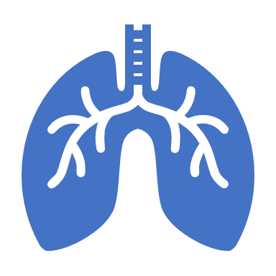
Respiration Disease .

Slide 3
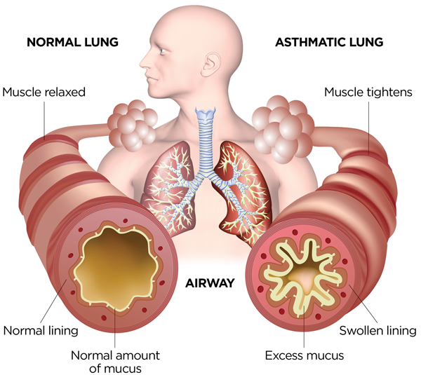
Asthma It is a disease in which the airways are narrowed. Due to chronic inflammation of the trachea. As a result, the trachea becomes more sensitive to various stimulants such as allergens and pollution. Signs of asthma are wheeze, cough especially during exercise and at night.

Slide 4
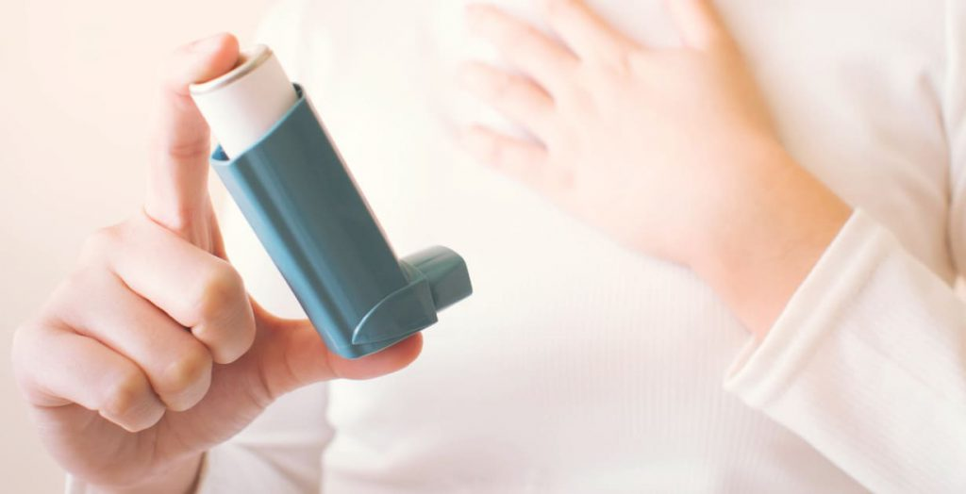
Causes and triggers of Asthma Asthma is caused by swelling (inflammation) of the breathing tubes that carry air in and out of the lungs. This makes the tubes highly sensitive, so they temporarily narrow. It may happen randomly or after exposure to a trigger. Common asthma triggers include: allergies (to house dust mites, animal fur or pollen, for example) smoke, pollution and cold air and Infections like colds or flu. Identifying and avoiding your asthma triggers can help you keep your symptoms under control.

Slide 5
Symptoms Asthma symptoms vary from person to person. You may have infrequent asthma attacks, have symptoms only at certain times — such as when exercising — or have symptoms all the time. Asthma signs and symptoms include: - Shortness of breath - Chest tightness or pain - Wheezing when exhaling, which is one of common in children - Trouble sleeping caused by shortness of breath, coughing or wheezing which can also be worsened by a respiratory virus, such as a cold or the flu.

Slide 6
Treatments for asthma Asthma is usually treated by using an inhaler, a small device that lets you breathe in medicines. The main types are: - reliever inhalers; used when needed to quickly relieve asthma symptoms for a short time - preventer inhalers; used every day to prevent asthma symptoms happening - Some people might also take tablets

Slide 7
Prevention Asthma can be lethal, Even though there are ways to prevent getting it. These are ways to prevent asthma: - Avoid contact with triggers that cause breathlessness, such as dust, cigarette smoke, dust mites, grass pollen, animal fur. - Avoid too cold or too hot weather. - Eat nutritious fruits and vegetables and drink warm water. - Avoid smoking - Avoid drinking alcohol

